Slide 1

ANNAMACHARYA INSTITUTE OF TECHNOLOGY AND SCIENCES::TIRUPATI (AUTONOMOUS) Venkatapuram(v), Karkambadi(p), Renigunta(m), Tirupati-517520, A.P DEPARTMENT OF COMPUTER SCIENCE AND ENGINEERING
EDUCATIONAL PERFORMANCE TRACKER
A Social Relevant Project
Guided By : Mr. T. Sreenivasulu Reddy
Team No:29
Team Members:
K. Laya (19AK1A0585)
P. Koteswara (19AK1A0578)
Y. Pavan Kalyan (20AK5A0506)
M. Jaya Krishna (19AK1A0570)

Slide 2
Contents
Introduction
Analysis
Design
Test Cases
Abstract
Existing system
Problem identification
Proposed system
Features
System Requirements
Modules
Database
Output screens
Conclusion
Reference

Slide 3
Introduction
To provide a way for educational institutions to monitor their student’s performance and for the students to know their academic performance and growth over the years is the reason for the making of this web site.
By offering constructive feedbacks to the students based on their performance, we are building a place for them to monitor their progress and improve themselves.

Slide 4
Social Relevant idea of the Project:
By using the Graph variance and Instructions generated according to the students perfomance in studies and attendance, the students can grow better and lead a better life in future.
Since these graphs and feedbacks are constructed based on their own past performance, this will better help them in having a better plan in studying.

Slide 5
Analysis :
The student performance analysis system provides an easy way for students in finding their academic attendance report and marks/percentage details along with their progress shown using a graph.
All the details of student’s attendance and marks are added by the admins. Students can use the credentials provided by their institute to login, view attendance, marks in graph-based format, and get a feedback.
Teachers can login, add new students to the database, and are able to remove a student from the database if necessary and they can also edit a student’s info. Basically, this system can help to maintain and manage the records of students, and help both the students and teachers.

Slide 6
Design :
The Educational Performance Tracker is designed to take input from admins. And this input can be the details of a student or the updated details of a student.
Based on the data given to the database by the admin, a graph will constructed to show the progress of each student when the site is accessed by a student.
Students can view their exam result and watch graph showing their progress over the past few years and get a feedback based on their performance.
The admins are provided with a way to upload a student’s details and also capable of deleting or update a student’s details in \ from the database.

Slide 7
Test Cases :
Checking the credentials entered in the Login page for wrong username or password.
Checking the username entered in the edit page to find a match in the database.
Verifying whether the delete and edit pages are working properly.
Checking whether the data provided by the admin is getting stored in the database properly.

Slide 8
ABSTRACT:
Educational Performance Tracker is a web-based Application for Educational institutions to track their student's academic performance and providing the same to their students. It saves information such as a student’s grades of previous years and attendance at a centralized student database and analyses them.
To ensure that educational activities are going in the Right direction & to fulfil the purpose of education, an institution will have to track their student’s progress. This application enables them to do so easily. Students can learn about themselves and improve by doing so through this application. Here we are offering constructive feedback, and continuous evaluation of performance can prove to be the turning point in the life of a student

Slide 9
Existing System:
In the College Login portal formats that we are being used, students can only view their exam results. Students are not getting the proper idea to improve their academic performance. Students are not using their profiles regularly as there is only a results portal and no further feedback and analysis on performance are provided.

Slide 10
Problem Identification
Since there are no helpful suggestions are provided in the college login portals, students are not able know their current progress and are in the dark about their individual progress.
Hence, a new system is required to help them identify their problems and plan better for their future.

Slide 11
Proposed System:
A web-page by using browser , for educational institutions that allows tracking student academic performance. This web provides users with access to interactive grading dashboards. Students can review such data as the overall curriculum progress, individual average grades, attendance, grade by subject, and others by using the graph analysis. It enables the students to fetch the required data at any given instant. Through graph analysis we'll provide instructions to grow the students in both attendance and studies.
Learning analytics, discriminative and generative classification models are applied to predict whether a student will be able to complete his degree or not. Graphical analytical results show that proposed method significantly outperforms existing methods due to exploitation of students information feature sets.

Slide 12
Features
We are providing the students to log in in the portal and view their personal performance and progress through the graphs provided.
Admins are now able to easily update any student’s information and remove or add a student with a few simple steps.

Slide 13
FEATURES
LOGIN for students and admin
Portal Management by Administrator Login
View results
View feedback based on their performance
Education
Performance
Tracker
Adding new students to the database
Graph constructed based on a student’s performance
Editing student details
Removing students from database
Fig : Educational Performance Tracker Features

Slide 14
System Requirements :
Hardware Requirements |  | Software Requirements
Development Environment | Targeted Environment | Development Environment | Targeted Environment
Intel i3 or i5 processor 4 GB RAM | 500 MB of free RAM Intel Pentium processor recommended | Microsoft windows 7 or 8 Web-Browser Notepad++ XAMPP | Any OS with Compatible Web Browser like chrome or firefox

Slide 15
Reasons for Choosing Hardware and Software Requirements :
Reason for choosing hardware and software is that , we are developing this Website by using HTML, CSS and PHP. So we will need any OS supporting a compatible web browser to run this site.
To support the web browser needed to run this Web application ,We need Pentium processor or later generation processor with 2GB of RAM or more.

Slide 16
Modules :
Login page for both students and admins
Results viewing page for students
Directing page for admins that includes a log out option
Add page
Edit or Remove page

Slide 17
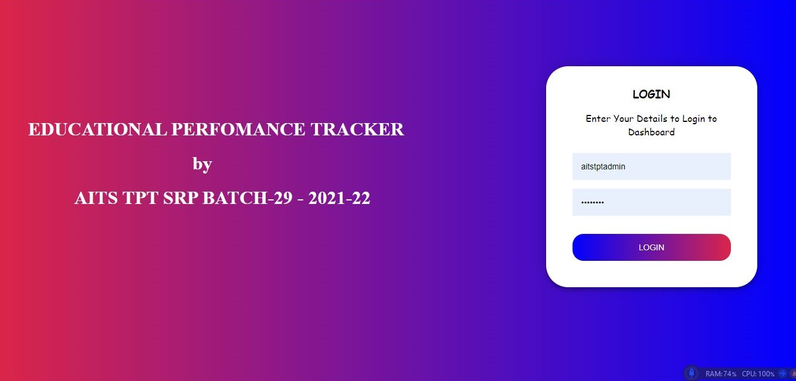
Login Page :
A page provided to help students and admins to login using their credentials. Based on their designations each user is directed to their respective page.

Slide 18
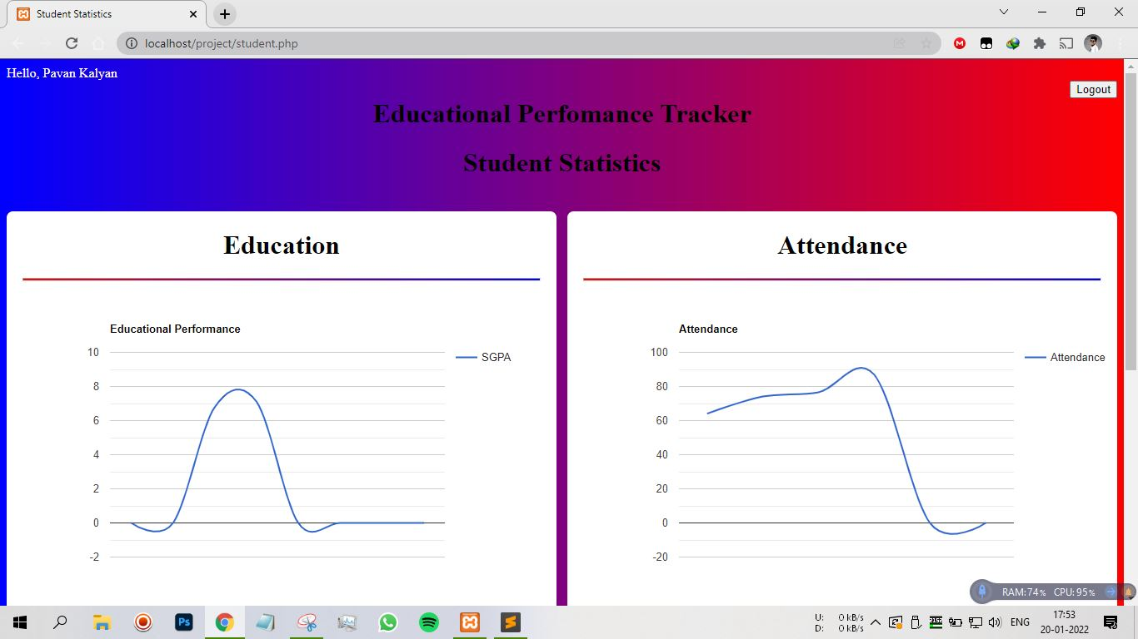
Results Viewing Page :
This page provides the results of a student along with a graph that shows their progress,

Slide 19
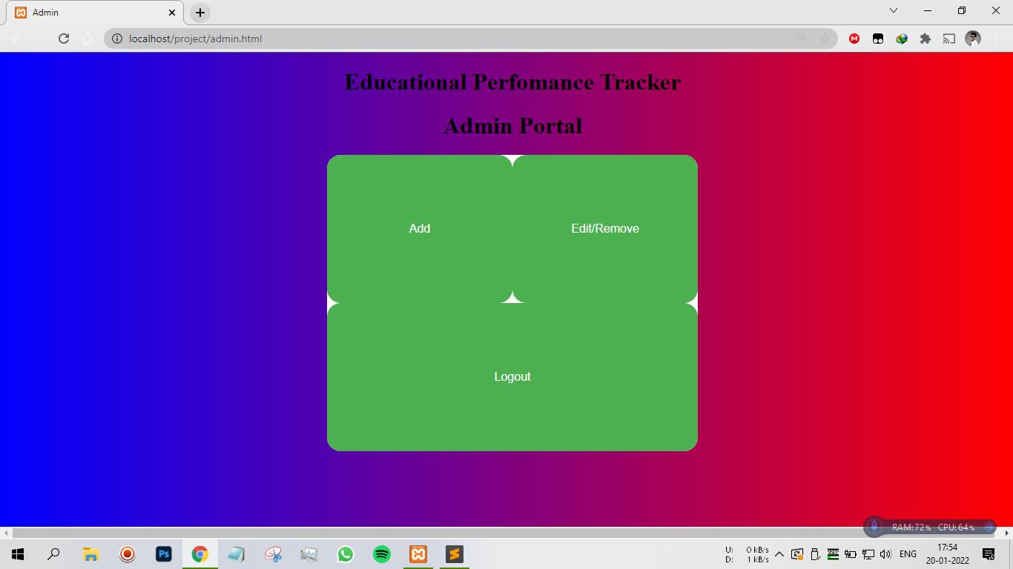
Admin Direction Page :
This page directs the admin to their desired page.
These directed pages include the edit and remove page and add page along with a log out option.

Slide 20
Add Student Page :
In this page, the admin is provided with a tools necessary to add a new student to the database.

Slide 21
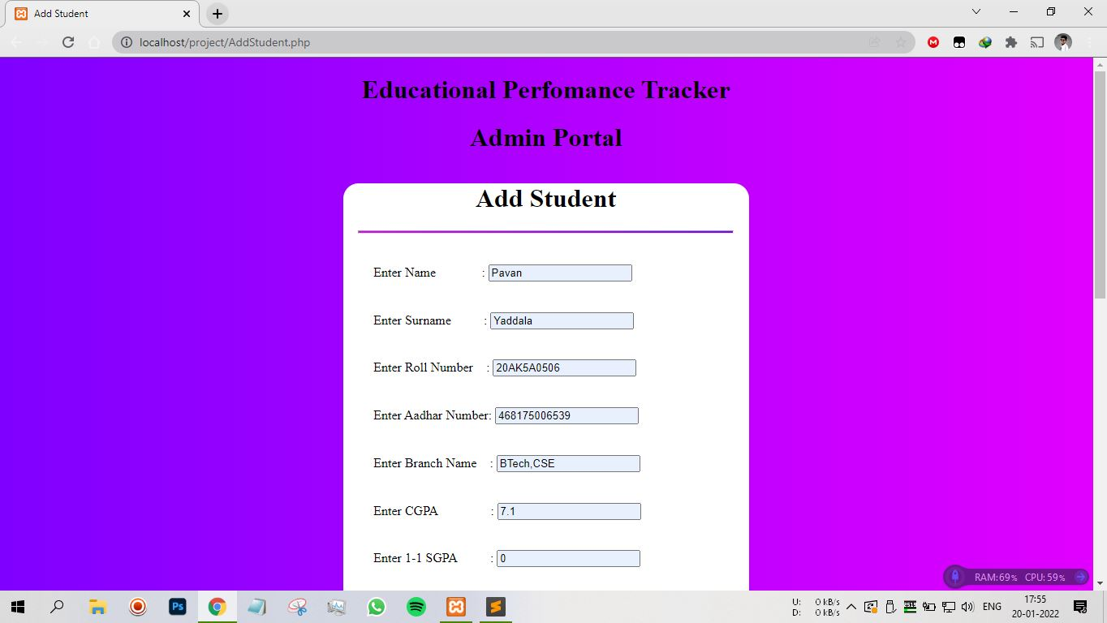
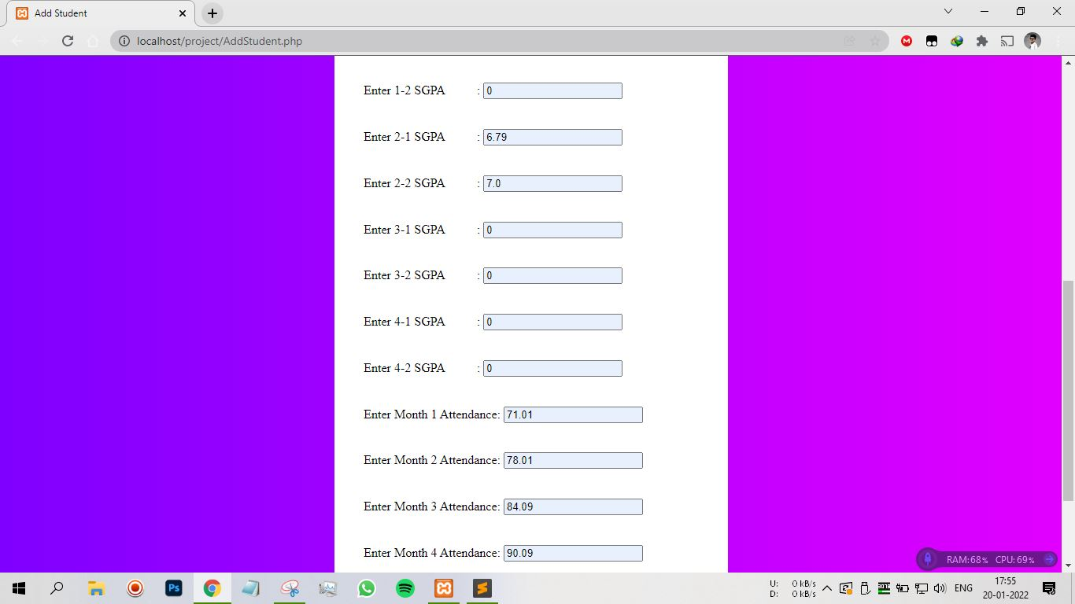
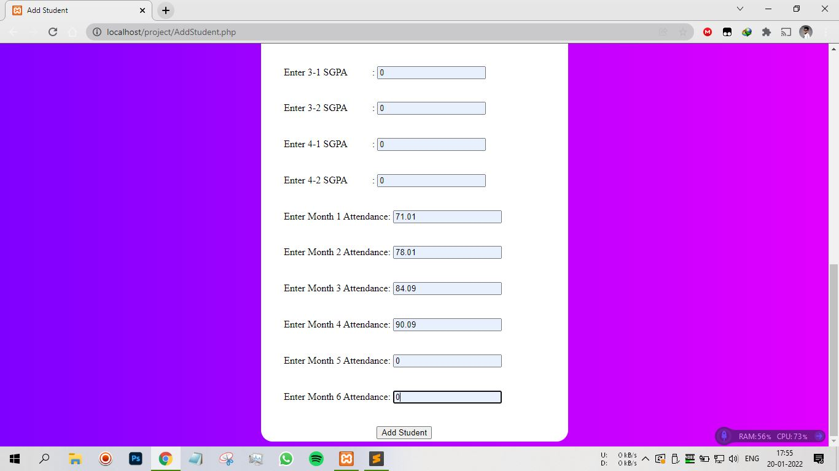
Add Page :

Slide 22

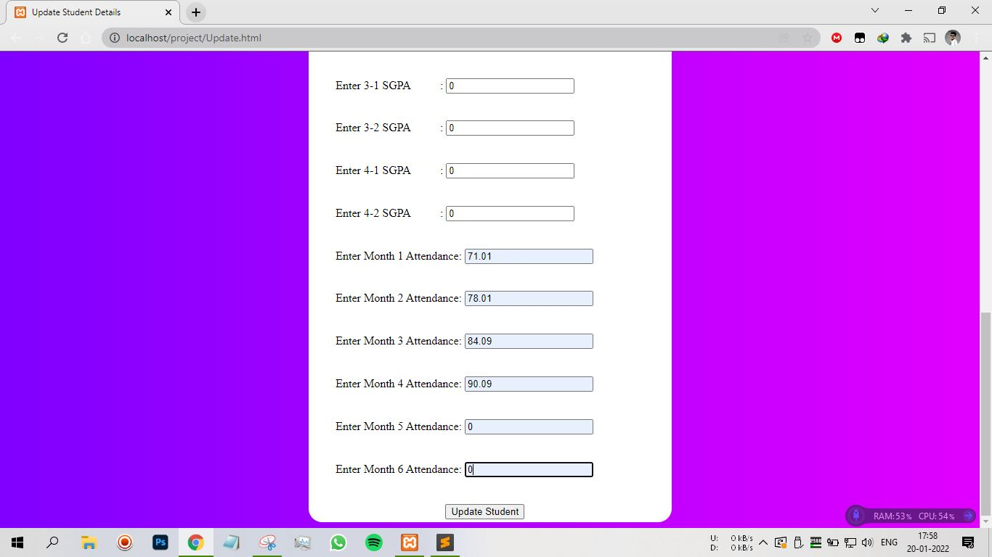
Edit and Remove Page :
This page provides to edit the details of a student or remove a certain student from the database.

Slide 23
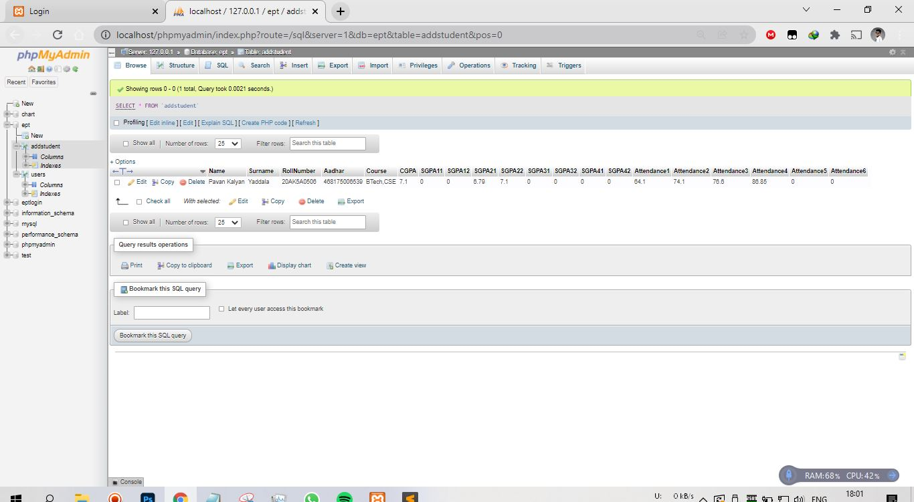
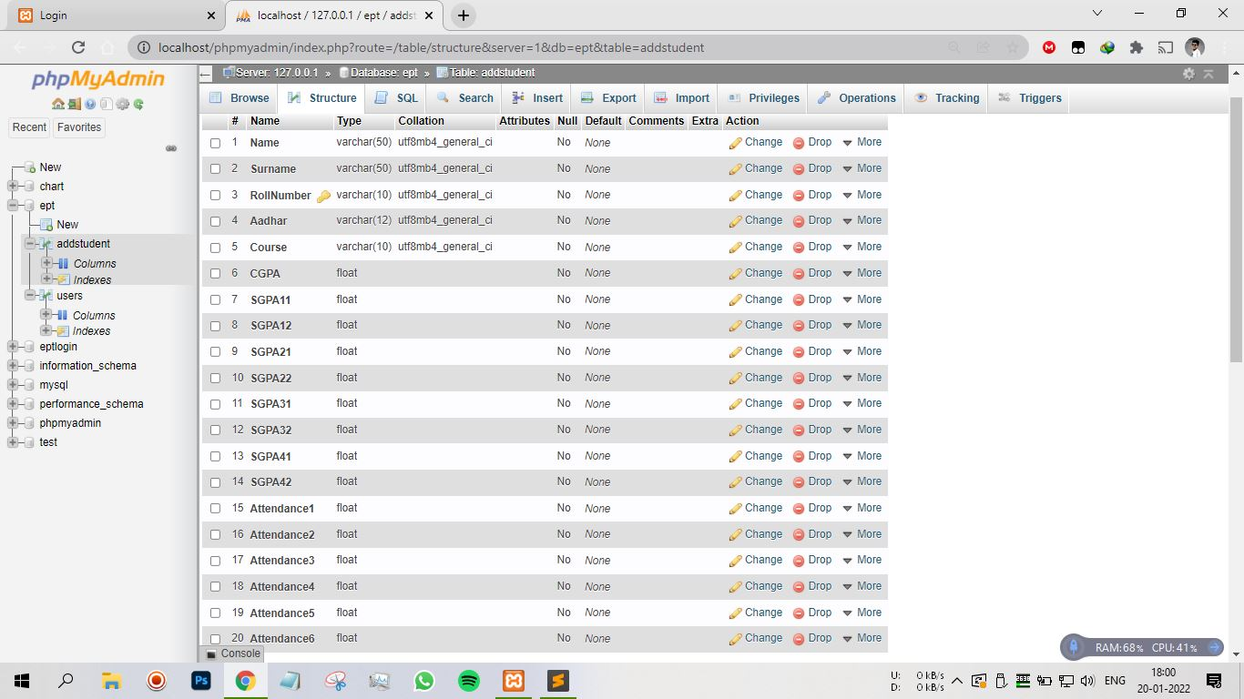
Output Screens :
These are the output screens that shows the results of the operations performed by the admin.

Slide 24
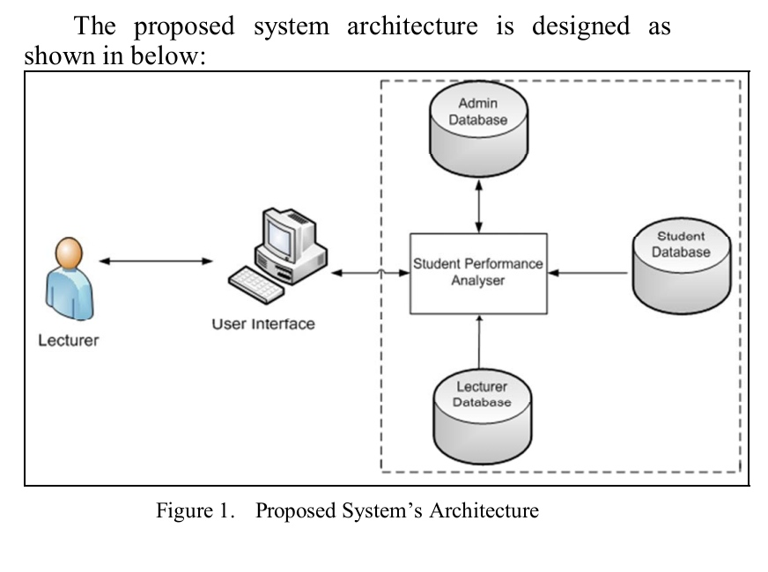
Flow Chart
Student

Slide 25
Conclusion :
This web site will help students in further understanding their progress over the past few years and gives a feedback to improve their performance.
Students will find this site very helpful in their academic growth.

Slide 26
References :
AITT Student login - https://examinations.aits-tpt.edu.in/SBLogin
AITT Staff login - https://examinations.aits-tpt.edu.in/StaffLogin
Education Tracking- https://en.wikipedia.org/wiki/Tracking_(education)
JNTU Login - https://studentservices.jntuh.ac.in/oss/login.html

Slide 27
Thank you

